Slide 1
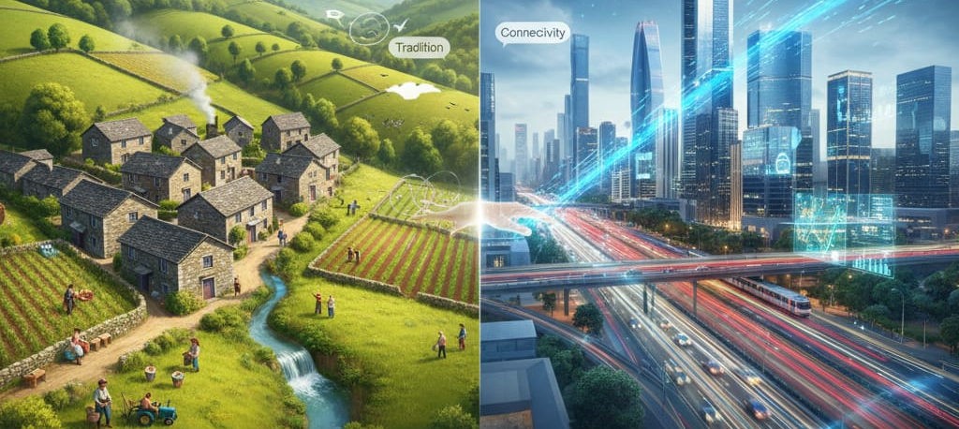
GEOGRAPHIC REGION AND RURAL ORIGIN DISCRIMINATION
PREPARED BY: DELİL AKSU

Slide 2
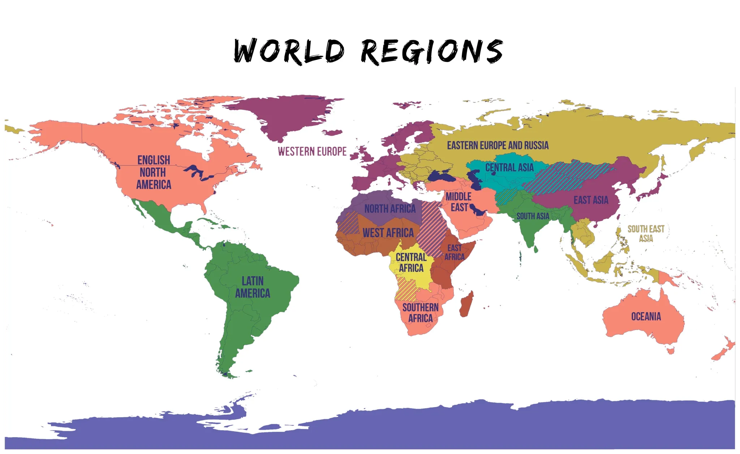
WHAT’S A REGION?
A region is an area that has common features such as climate, culture, or geography.
It helps us group places to understand them more easily.

Slide 3
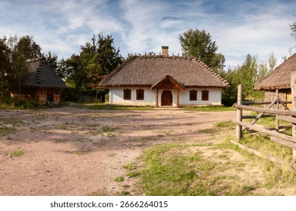
WHAT IS A RURAL ORIGIN?
Rural origin means coming from a countryside area with low population and more natural surroundings

Slide 4
PRESENTATION FOCUS
DEFINITIONS:
GEOGRAPHY OF OPPORTUNITIES: Geography of opportunities means how different places offer different chances for education, jobs, and a better life.
ORIGIN: A person’s background or where they come from.
IDENTITY: The qualities, beliefs, and charecteristic that make a person who they are.

Slide 5
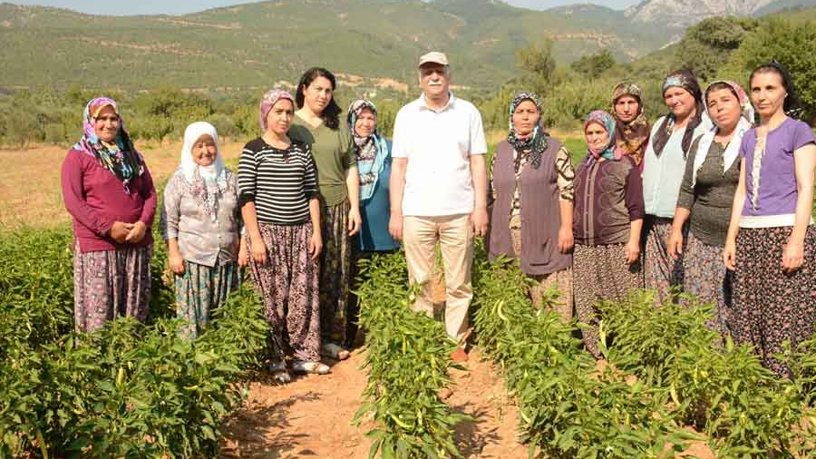
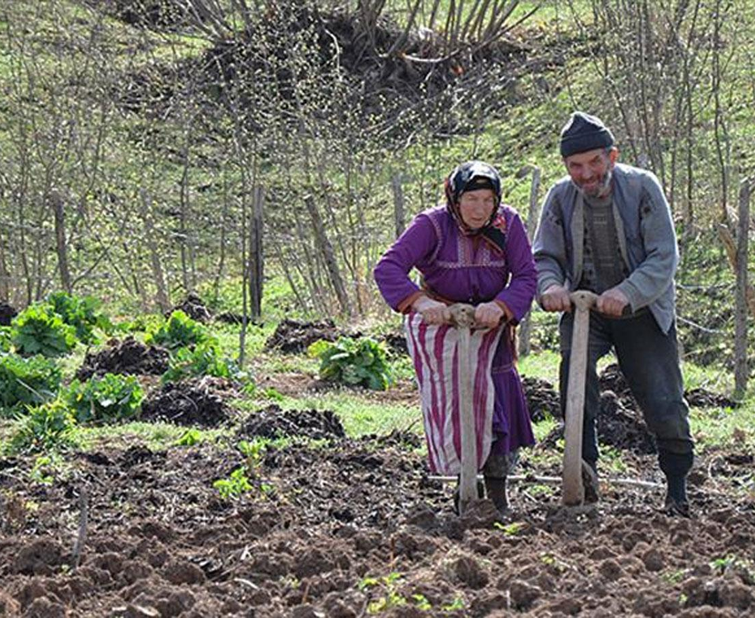
THE GEOGRAPHY OF OPPORTUNITIES
Opportunities are unequal. Rural people need access to welfare, healthcare, education and digital connectivity.

Slide 6
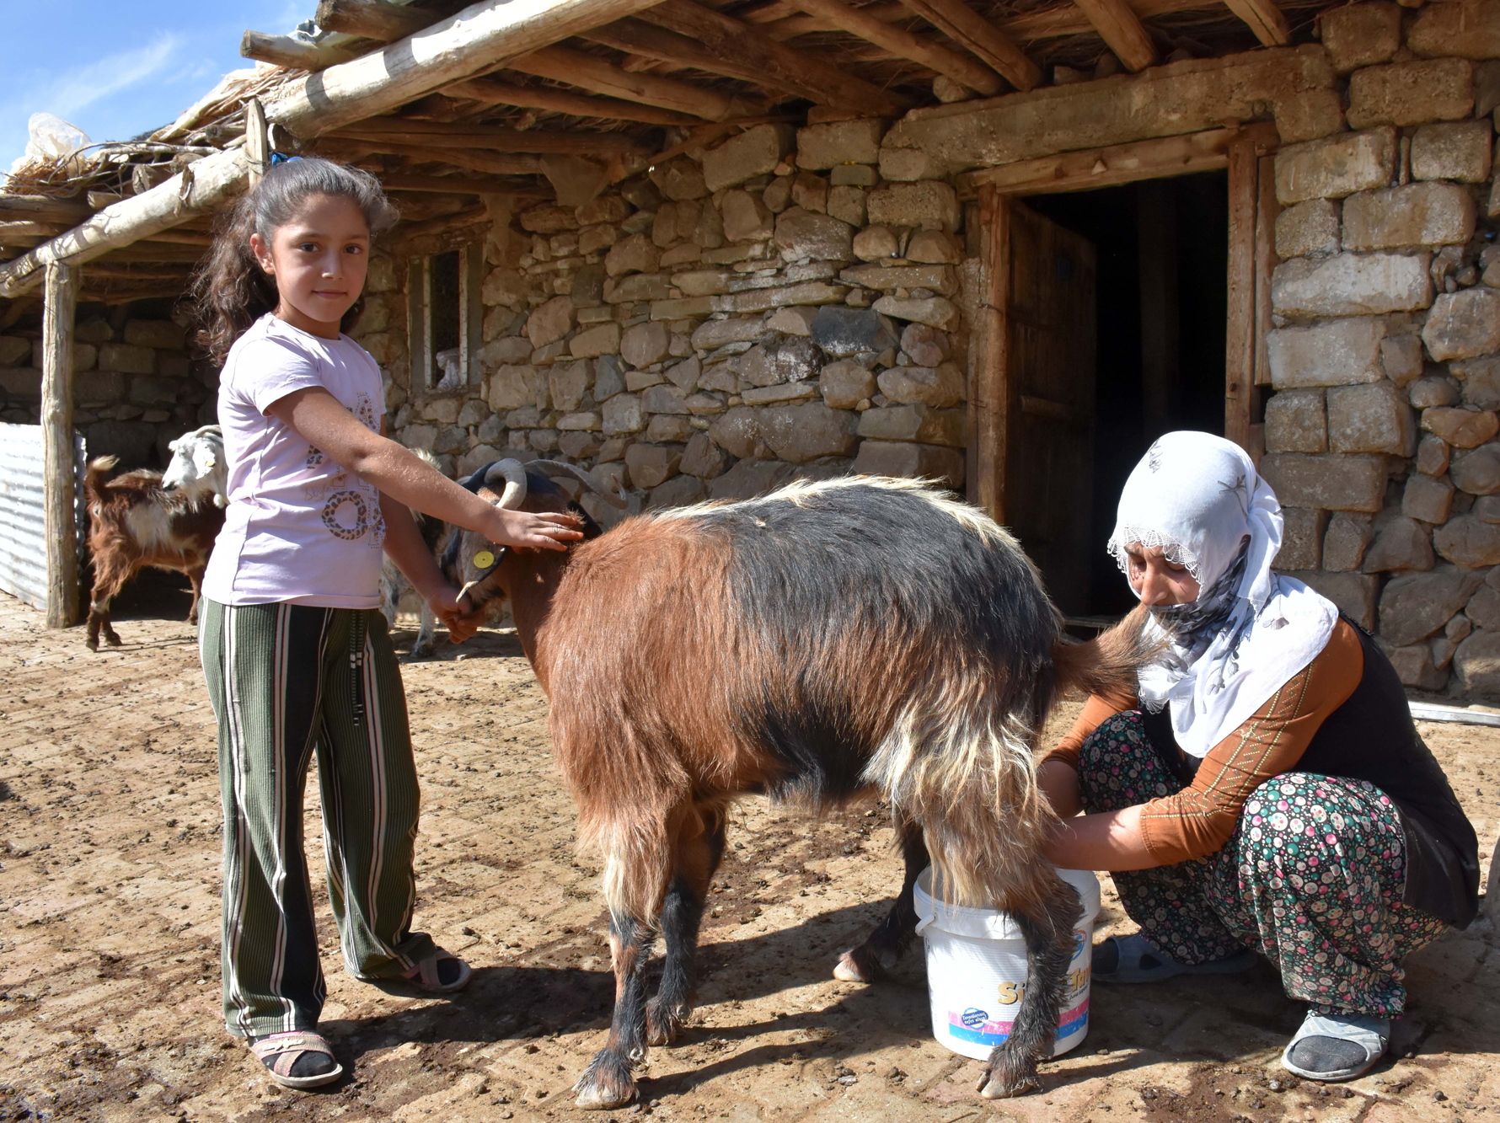
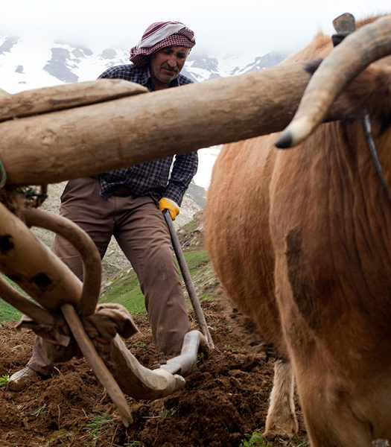
RURAL CHALLENGES
Daily life in rural areas is more difficult because Access to basic services is limited.
Distance and lack of infrastructure slow down economic development in rural areas.

Slide 7

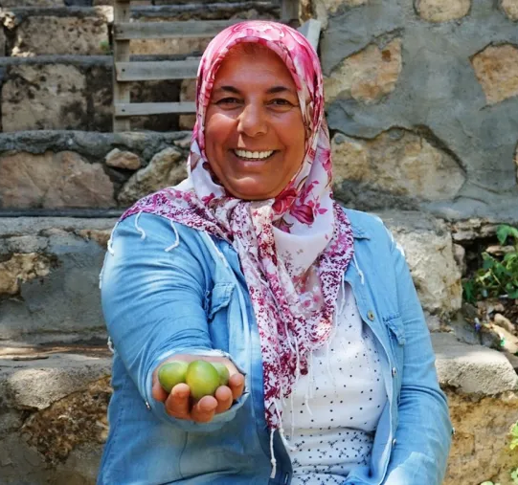
RURAL OPPORTUNITIES
Large areas in rural areas offer significant opportunities for renewable energy projects.
Local tourism and organic farming can create new economic opportunities for rural communities.

Slide 8

ORIGIN SHAPES IDENTITY
The phrase “origin shapes identity” describes how an individual’s identity is shaped by their roots and past experiences.
Where a person comes from deeply affects their values, perspective and way of perceiving the world.

Slide 9
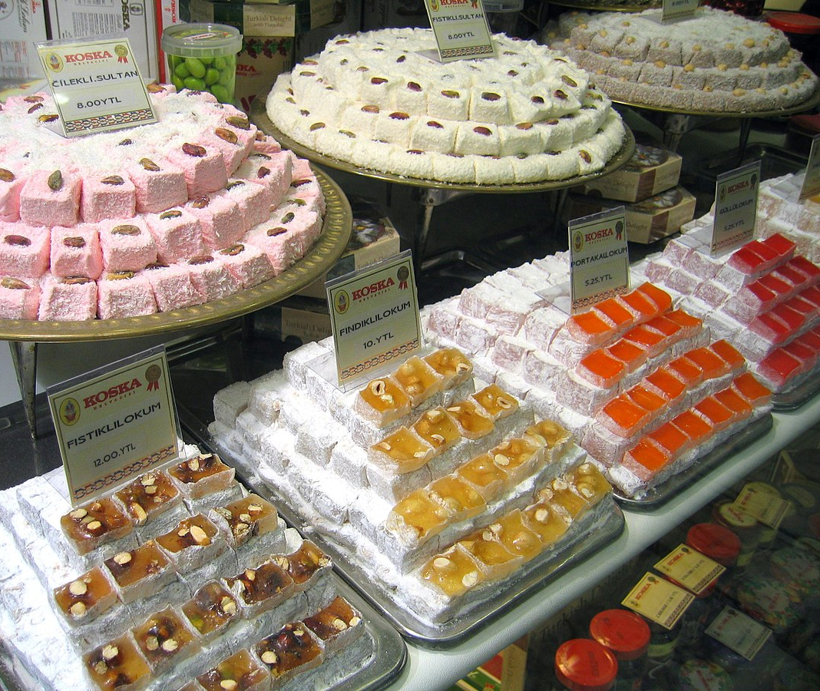

GEOGRAPHICAL INDICATIONS
Quality and reputation are often shaped by the conditions, culture and values ​​of the region in which they are located.
The business culture, education level and social trust of a region directly affect the reputation of the institutions and individuals in that region.
For example: Turkish delight and Turkish coffee.

Slide 10
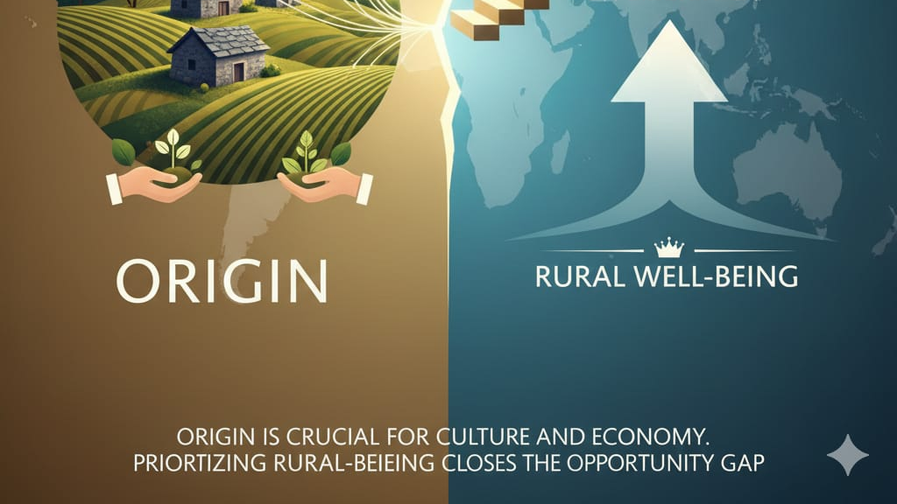

Slide 11
ARTICLE TITLE: RURAL WELL – BEING: GEOGRAPHY OF OPPORTUNITIES
RESOURCE: https://www.aeidl.eu/news/opinions/rural-well-being-geography-of-opportunities/
Key points related to article:
Opportunities are unequal. Schools and hospitals are fewer in rural areas.
A good life (welfare) isn't just about money; it's about health and a happy community.
The government should provide more assistance to rural areas so everyone has equal opportunities.

Slide 12
WHAT DO YOU THNK?
Do you fell your origin (the place you grew up)is important for your identity?
What is the best part of living in a village?
Should the government help rural schools more than city schools? Why?

Slide 13

Thank you for listening to me.

